Slide 1

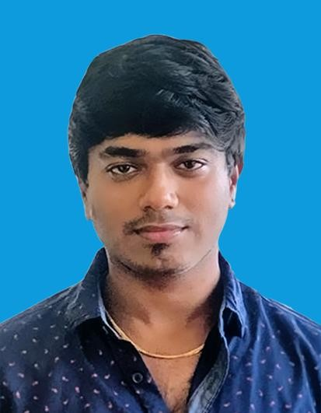
Madhan kumar D
Education and certificates Bachelor of Technology Information Technology : 2016 -
2020
Certificates
MuleSoft Certified Developer Level -1
Agile Methodology certificate
Analyst/Software Engineer
Base Location: Chennai
Email ID: madhan.kumar-d@capgemini.com
Mobile No: +91 8870425093
Grade: A4
Skills
Mule 4
Agile Development
Competencies
Basic understanding on Integration Principles and Design Patterns.
Ability to design using AnyPoint Platform to build, deploy, manage, and govern APIs.
Good knowledge on MuleSoft Integration Best Practices
Integration Experience
Designed and developed RAML based API using Anypoint platform and imported the RAML to Anypoint Studio to build the Mule Application
Used Dataweave transformations to transform message to target formats like JSON, XML, CSV, etc. and have worked on various operators like map, pluck, Arrays, lookup and filter.
Database
SQL database - MySQL, PostgreSQL
AddOns Postman
Github
Has Good understanding on Agile methodology.
Hands on experience in building API-led and Connector- based integrations.
Used Database and HTTP connectors to implement API methods to fetch data from database.
Have basic knowledge on Web Technologies – HTML,
CSS, JavaScript, Angular, Typescript.
Creating CI pipelines in Azure to clone the source code from Git, execute Munits and deployment on Cloudhub.
Implemented basic Mule flows using Scopes, Error handling Strategies, Validation, Flow controls, Transformations.
Mule Specifies
RAML, Exchange, Standard connectors, API Manager, Runtime Manager, Access Management, Dataweave, Scheduler, Exception handling, Logging, MUnit, Monitoring
Additional Details
Excellent Communication Skills
Team Player
/
Presentation Title | Author | Date © Capgemini 2017. All rights reserved |

